Slide 1
Road Accident Analysis and Risk Assessment Dashboard
Presented by Sudharsan Raamakrishnan

Slide 2
Project Overview
This project focuses on analyzing road accident data to uncover patterns, trends, and risk factors that contribute to accidents.
An interactive dashboard was developed to provide insights into accident distribution based on time, location, severity, and other influencing factors.
The primary objective is to enable data-driven decision-making by presenting complex data in a clear and visually intuitive manner, ultimately contributing to improved road safety and risk management.

Slide 3
Problem Statement
Road accidents are a critical public safety issue, leading to significant loss of life, injuries, and economic damage every year.
Key problems include:
Difficulty in identifying accident-prone regions
Lack of clarity on time-based accident patterns
Limited understanding of contributing factors such as road conditions, weather, and driver behavior
This project aims to address these challenges by transforming raw accident data into an interactive and insightful dashboard that supports data-driven decision-making for improving road safety.

Slide 4
Dataset Information
Source: Kaggle
Size: 20,000 rows
Fields: Time, Location, Accident Severity, Accident Causes, Road Type, Vehicles, Total Casualties, Weather Conditons, Risk Level

Slide 5
Tools & Technologies
Advanced Excel: Data Cleaning
Power BI: PQE Editor, ETL, Modeling, Dashboard

Slide 6
Data Cleaning & Transformation
Removed duplicates
Handled missing values
Standardized formats
Used Power Query for ETL

Slide 7
Dashboard Overview
Charts: Line Chart,Pie & Donut Chart,Bar Chart
Cards: KPI Measures
Scatterplot
Interactive Maps

Slide 8
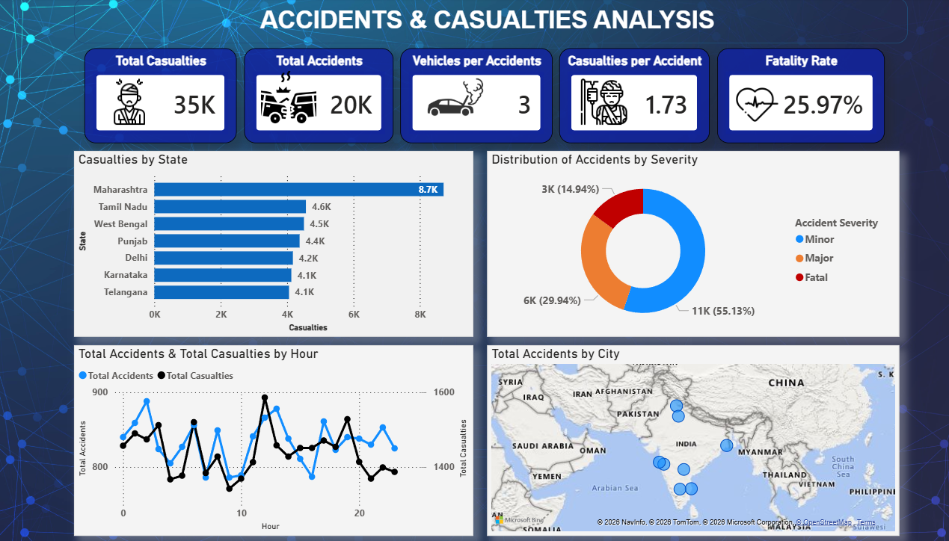
Dashboard Preview - Page 1

Slide 9
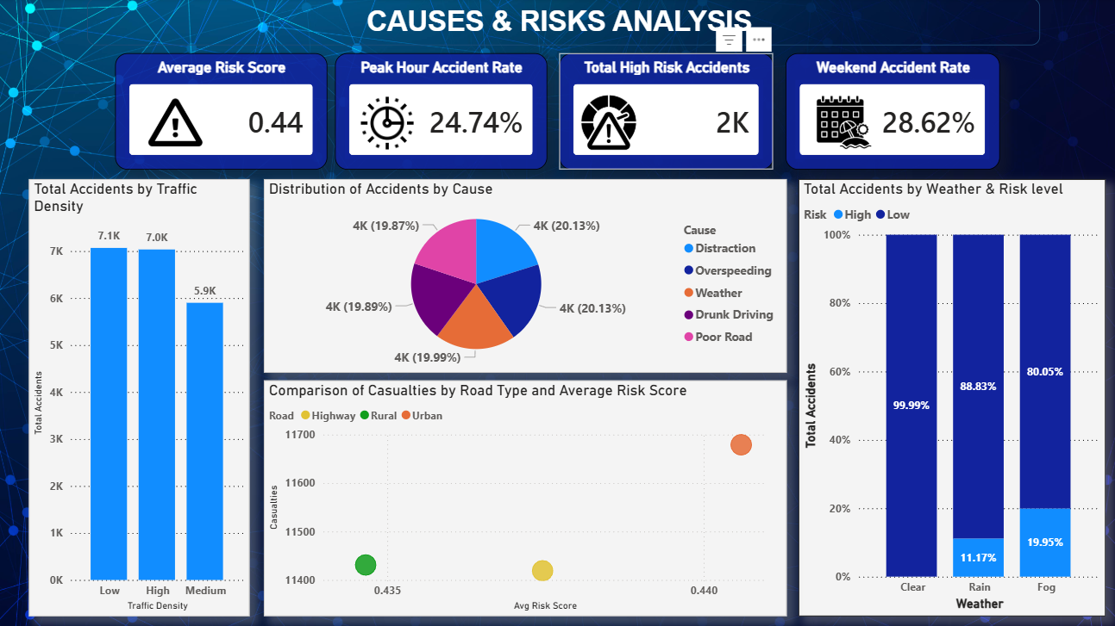
Dashboard Preview - Page 2

Slide 10
Key Insights
Peak Accident hours identified
High-risk regions found
Patterns based on time and conditions
Leading causes of accidents identified

Slide 11
Future Enhancements
Can be further enhanced using Real-time data
Predictive analytics through Machine Learning concepts such as CNN,RNN etc., can be used to identify and prevent future accidents.
Enhanced geographic mapping can applied to identify future hotspots

Slide 12
Conclusion
By leveraging tools like Excel and Power BI, the dashboard effectively highlights accident trends, high-risk areas, and key contributing factors.
The insights derived from this analysis can assist authorities, policymakers, and stakeholders in making informed decisions to reduce accidents and improve road safety measures.

